Slide 1

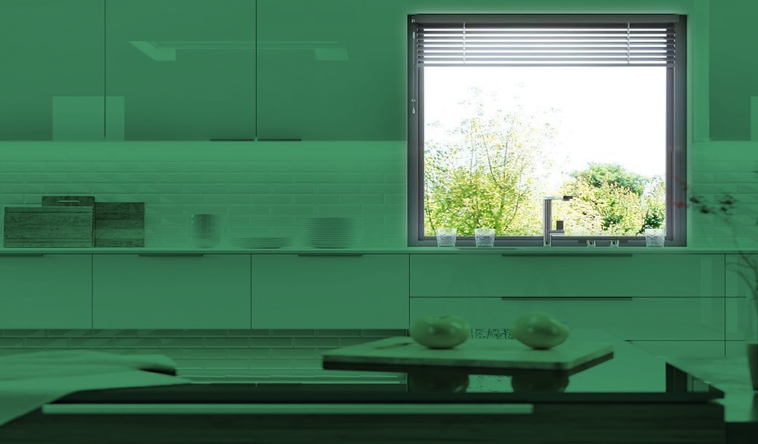

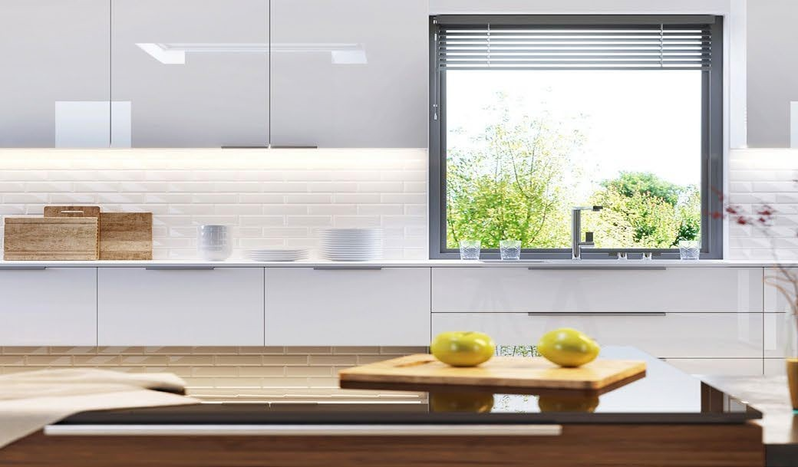
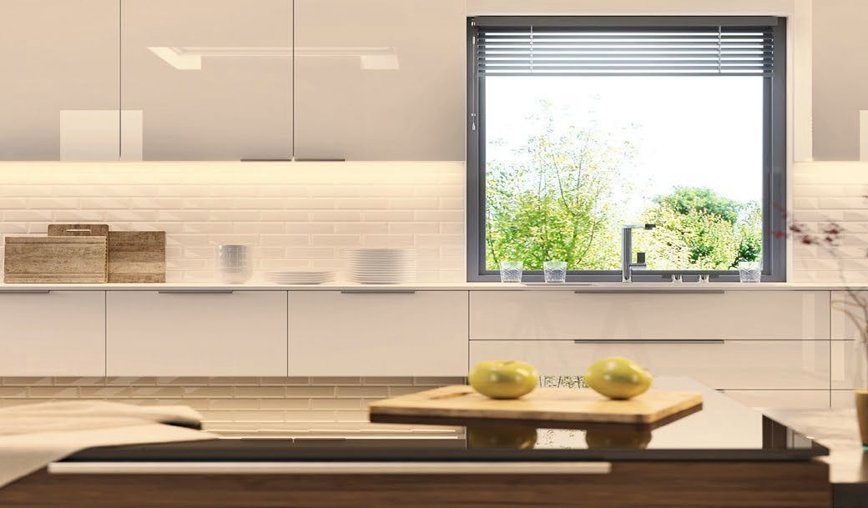




[Dealer Name]
[Your tagline, e.g. Lighting Design and Installation]
[000.000.0000] | [yourwebsite.com]
[City, State] | [License #]
COLOR CAST™
Love the trend.
Skip the remodel.
Dark green cabinets and backsplash are the look right now. With Color Cast lighting you can have it tonight, on the surfaces you already own, and change it whenever you like.
Same kitchen. Any look.
Change it with a tap, your voice, or a wall remote
Built neutral
Timeless white surfaces
Tonight: Forest Green
On trend, no new tile
Every day: Warm White
Cooking and gathering
Game day: Team Colors
Holidays and parties too
Same kitchen, same surfaces. Looks shown are simulated for illustration.
Change the light, not the kitchen
Changing surfaces
Changing the light
New cabinets, paint, or tile to chase a color
Demolition, dust, and weeks of waiting
Can look dated when tastes change
Keep your surfaces neutral and timeless
Try a bold color tonight, a new one next season
Back to warm white with one tap
Choose your light
Two simple choices, or combine them
3000K
Classic White 3000K
Color Cast Multi-Color
Warm, inviting, and timeless. Flatters wood, stone, food, and skin tones.
Any color you can imagine, including variations of white. Set scenes and schedules.
Great for: Under-cabinet, stairs, closets, vanities, coves
Great for: Kitchens, media rooms, bars, bedrooms, patios*
PLAN YOUR LIGHTING
Ask us for a live Color Cast demo in your own space.
Rooms
Kitchen
Bath
Living
Bedroom
Light
White 3000K
Color Cast
Both
Stairs
Media
Bar
Outdoor*
Control
App
Voice
Wall remote
My colors
Next step
Demo
Proposal
Schedule install
Notes
*Outdoor and damp locations require wet-rated tape, channel, and connections.
Color Cast™ lighting by LIGHTING LEAF
[Dealer Name] | [000.000.0000] | [yourwebsite.com]
Notes:
DEALER TALK TRACK (not printed)
Use this sheet at the walkthrough. Fill in Plan Your Lighting with the client.
1. ASK: "What colors or styles are you loving right now?" Write it on the My colors line.
2. SHOW: Set the room, or your demo strip, to that color from the app on the spot.
3. CLOSE: "Keep your surfaces timeless. Change the color anytime."
Quote Classic White 3000K as the base and Color Cast as the alternate on every proposal.
"Will color look tacky?" Most of the time it runs warm white. Color is for the moments they want it.
"Can I just get white?" Yes. Classic White 3000K is the best everyday white.
"What if I don't like it later?" Change it in seconds. No new tile, no repaint.

Slide 2






Make this sheet yours
Dealer setup guide. About 5 minutes in PowerPoint. This page is hidden and will not print.
1
Add your logo
Right-click the YOUR LOGO box, choose Change Picture, then From a File. Your logo drops in at the same size and position. A PNG with a transparent background works best.
2
Add your info
Click each [bracket] field and type over it: dealer name, tagline, phone, website, city, and license number. The footer has a second set of fields. Delete the brackets.
3
Set your brand color
Design tab > Variants > Colors > Customize Colors. Set Accent 1 to your main brand color and Accent 2 to your secondary color, then Save. Every accent on the sheet updates at once.
4
Match your fonts (optional)
Design tab > Variants > Fonts > Customize Fonts. Set Heading and Body to your brand fonts. The sheet uses Arial by default so it opens the same on any computer.
5
Save and print
File > Export > PDF for email and your website. To print, print slide 1 only and choose Fit to Page. Save your finished copy as your own master so you only do this once.
Co-brand rules
Your brand leads. Your logo, color, and contact info go at the top and in the footer.
Keep the "Color Cast™ lighting by Lighting Leaf" credit in the footer.
Keep the "simulated for illustration" note and the outdoor wet-rated footnote.
Keep product descriptions as written. Check with Lighting Leaf before changing product claims.
If you swap in your own job photos, you can remove the simulated-image note for those photos.
Arizona contractors: include your ROC license number where required.
Need help or want us to set it up for you?
Send your logo, brand colors, and contact info to Lighting Leaf dealer support:
sales@lightingleaf.com | 602.625.8608
Color Cast™ lighting by LIGHTING LEAF
lightingleaf.com

