Slide 1


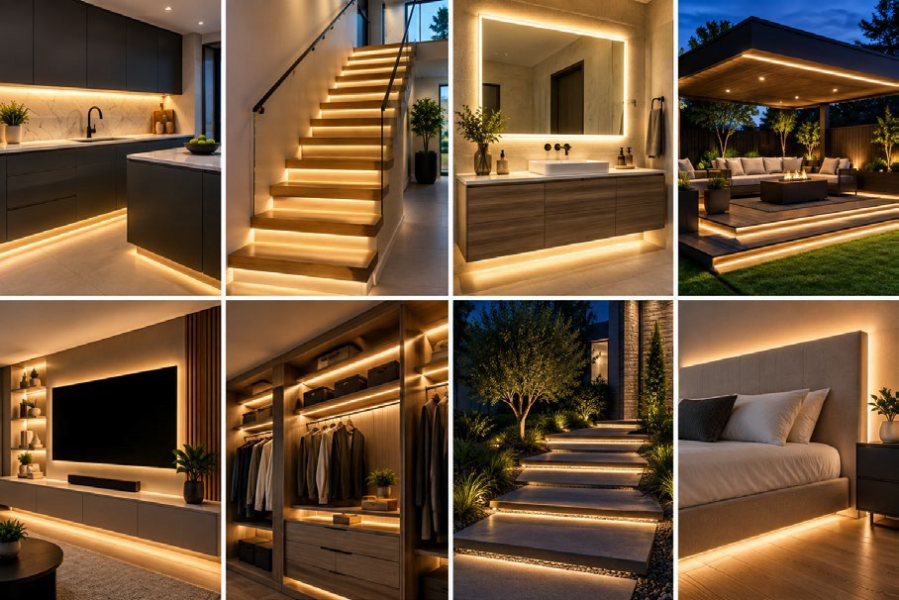

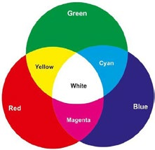
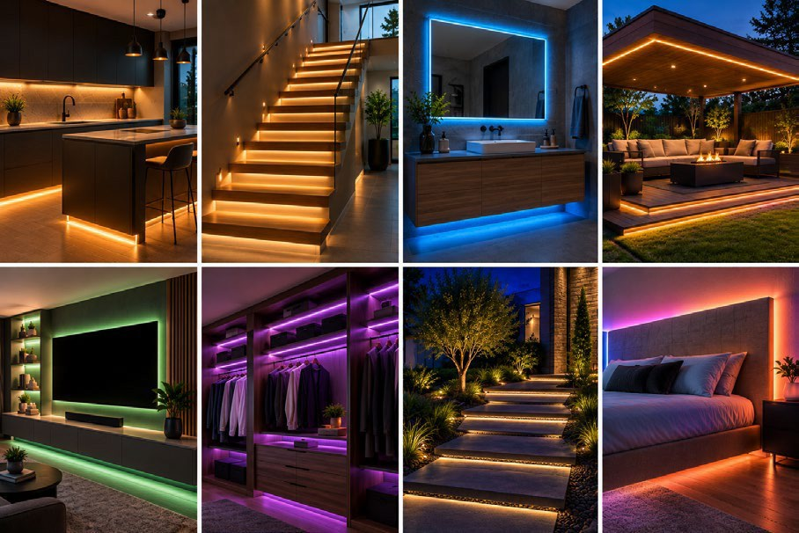

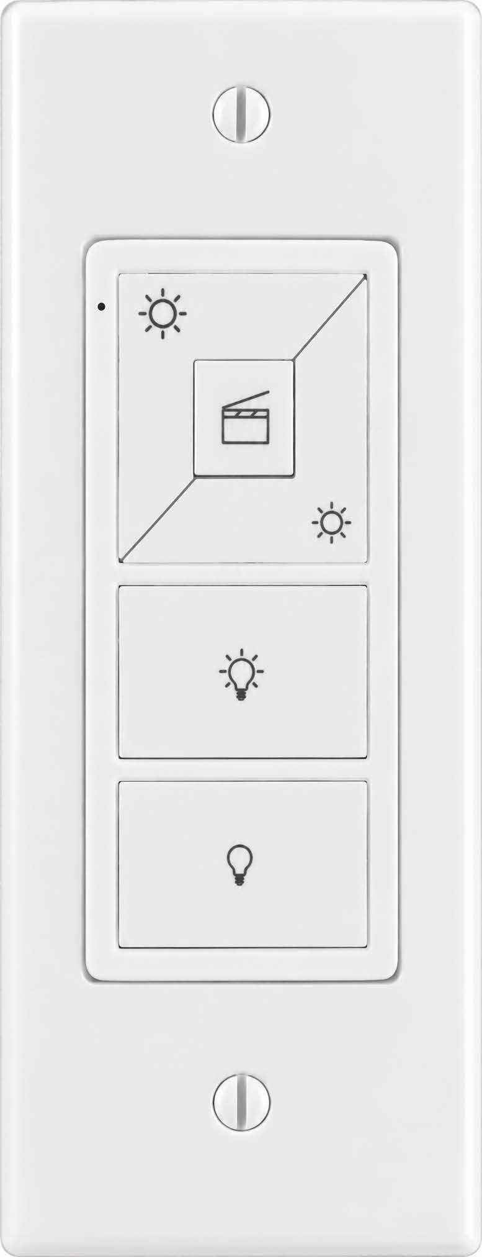
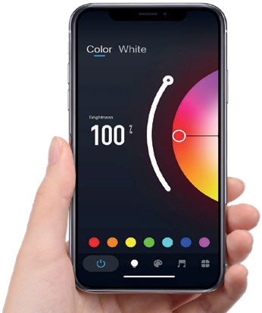

[Dealer Name]
[Your tagline, e.g. Lighting Design and Installation]
[000.000.0000] | [yourwebsite.com]
[City, State] | [License #]
Style with perfect white light
3000K
Classic White
3000K
3000K is a warm-neutral white that balances clarity and material beauty.
One fixed white. Simple, clean, and efficient for task and accent lighting.
Creates a warm, inviting atmosphere that supports focus or comfort.
Light interacts with architecture to create depth rather than flat, uniformly lit spaces.
Seamless, dot-free options: Lighting Leaf PhosCore™ tape produces one continuous line of light with no visible dots, even reflected in glossy counters, tile, and floors.
Set the mood with colored light
Color Cast
Multi-Color
COLOR CAST™
Millions of colors for accents, parties, holidays, and game day.
Colors available by mixing primary colors, including variations of white.
Change the look anytime without altering surfaces or décor.
Features, functions, and benefits
Color Cast lighting: change the look anytime without altering surfaces or décor.
Feature | What it does | What it means for you
Slim, flexible strip | Fits under cabinets, in coves, on steps, and in tight spaces | Light exactly where you need it, with the fixture out of sight
Seamless, dot-free glow | Blends LEDs into one continuous line of light | Clean reflections on glossy counters, tile, and floors
90+ CRI white light | Shows colors much the way daylight does | Finishes, food, and skin tones look natural
Dimmable, color on demand | Adjusts brightness; Color Cast adds any color | One room, many moods: work, relax, entertain
Indirect, reflected light | Softens glare and harsh shadows | Easier on the eyes, and rooms feel larger
Smart control | App, voice, wall remotes, scenes, and schedules | Convenience from anywhere; never come home to a dark house
Energy-efficient LED | Low wattage and long service life | Lower energy use and less upkeep
Control it your way
Why a professional install?
Tap or speak: dim, brighten, and change color via the app or smart assistant
Stylish, removable in-wall remote / switch for everyday use
Scenes for cooking, movie night, and entertaining
Schedules and timers: wake to a gentle glow, come home to a lit house
Power supplies sized to each run for reliable performance
Correct wire gauge for even brightness from end to end
Clean, concealed wiring and finished setup details
Local support from the pro who designed your lighting
Ask us for a live demo in your own space.
LED tape lighting by LIGHTING LEAF
[Dealer Name] | [000.000.0000] | [yourwebsite.com]
Notes:
DEALER TALK TRACK (not printed)
1. Start with white: most rooms are sold on Classic White 3000K. Point to the white collage.
2. Then show color: "What colors are you loving right now?" Set it from the app on the spot.
3. Walk the features table: pick the two or three rows that matter to this client.
Quote Classic White 3000K as the base and Color Cast as the alternate on every proposal.

Slide 2






Make this sheet yours
Dealer setup guide. About 5 minutes in PowerPoint. This page is hidden and will not print.
1
Add your logo
Right-click the YOUR LOGO box, choose Change Picture, then From a File. Your logo drops in at the same size and position. A PNG with a transparent background works best.
2
Add your info
Click each [bracket] field and type over it: dealer name, tagline, phone, website, city, and license number. The footer has a second set of fields. Delete the brackets.
3
Set your brand color
Design tab > Variants > Colors > Customize Colors. Set Accent 1 to your main brand color and Accent 2 to your secondary color, then Save. Every accent on the sheet updates at once.
4
Match your fonts (optional)
Design tab > Variants > Fonts > Customize Fonts. Set Heading and Body to your brand fonts. The sheet uses Arial by default so it opens the same on any computer.
5
Save and print
File > Export > PDF for email and your website. To print, print slide 1 only and choose Fit to Page. Save your finished copy as your own master so you only do this once.
Co-brand rules
Your brand leads. Your logo, color, and contact info go at the top and in the footer.
Keep the "LED tape lighting by Lighting Leaf" credit in the footer.
Keep the PhosCore™ and Color Cast™ names and marks as shown.
Keep product descriptions as written. Check with Lighting Leaf before changing product claims.
You may swap the room photos for your own installed job photos.
Arizona contractors: include your ROC license number where required.
Need help or want us to set it up for you?
Send your logo, brand colors, and contact info to Lighting Leaf dealer support:
sales@lightingleaf.com | 602.625.8608
LED tape lighting by LIGHTING LEAF
lightingleaf.com

