Slide 1

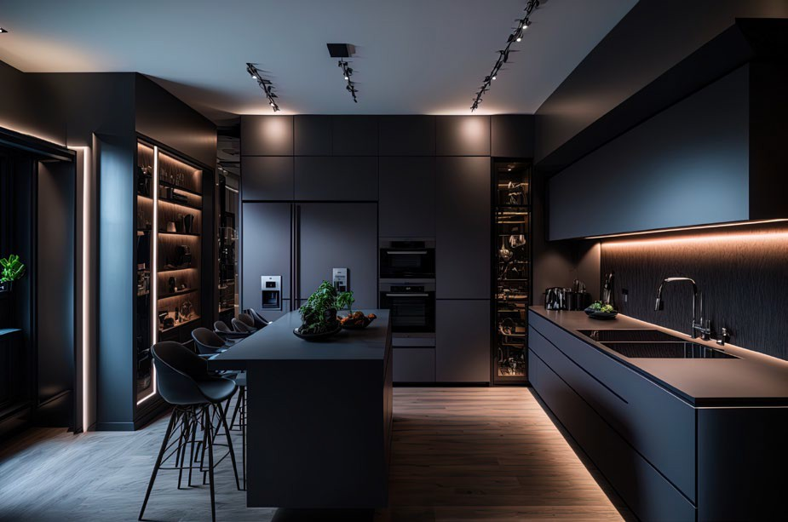














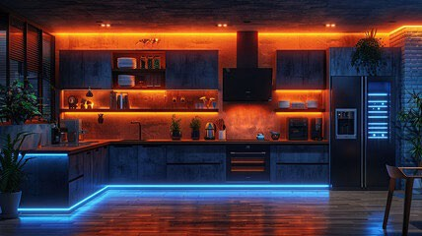
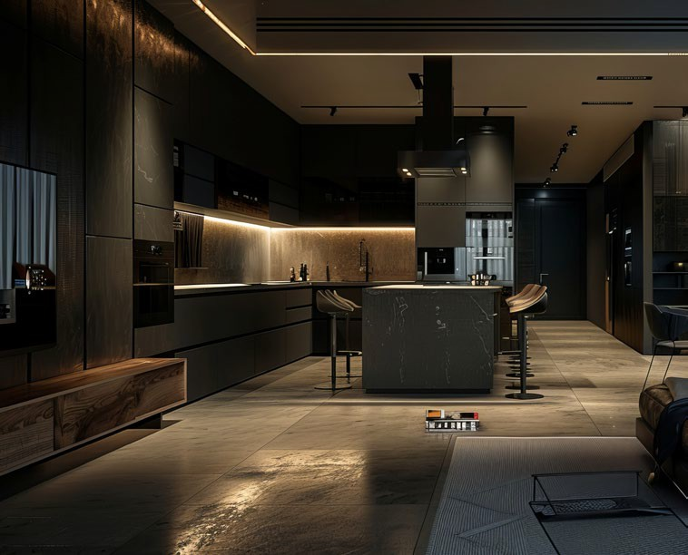
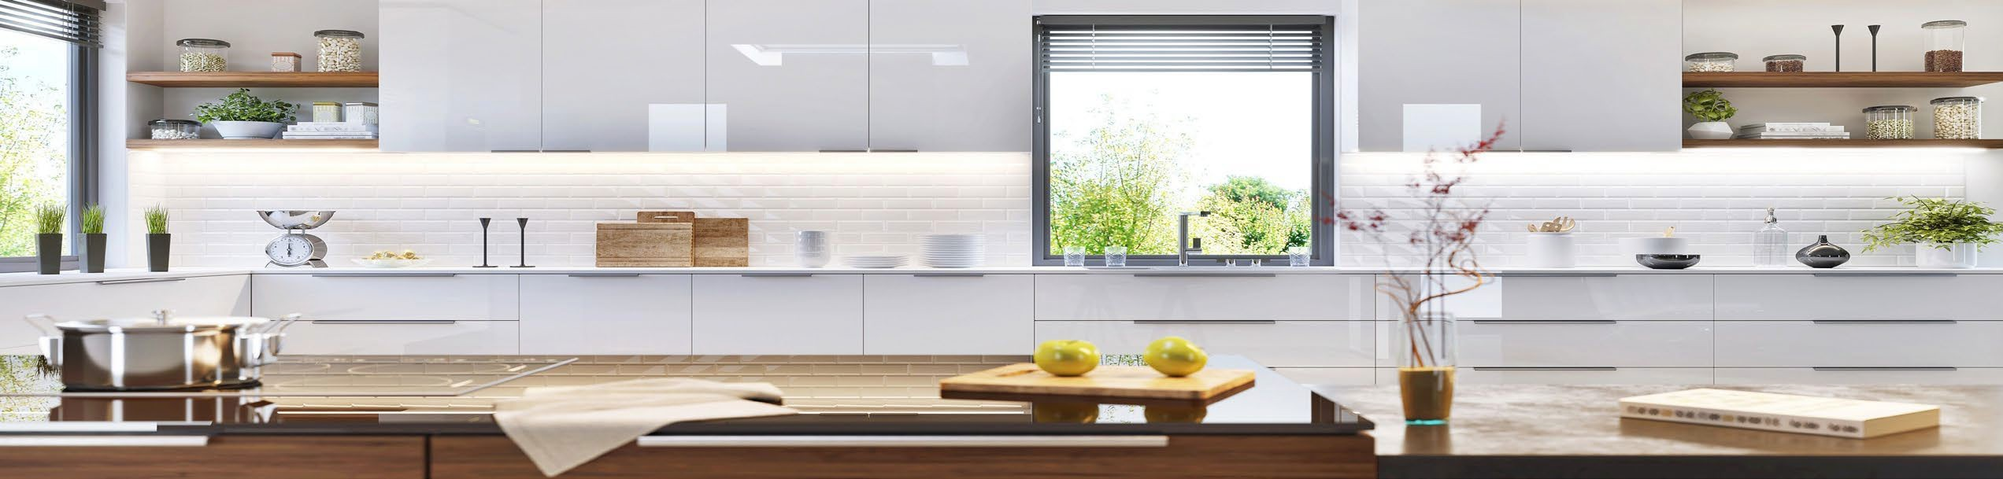
[Dealer Name]
[Your tagline, e.g. Lighting Design and Installation]
[000.000.0000] | [yourwebsite.com]
[City, State] | [License #]
Beautiful light,
hidden in plain sight.
LED tape tucks out of sight under cabinets, inside ceiling coves, along stairs, and behind shelves. You see a warm, even glow that shapes the room, not the fixture that makes it.
What is LED tape lighting?
Low-Voltage
Efficient 24V power
Cut to Fit
Custom lengths, every run
A thin, flexible strip lined with small, efficient LEDs. Your installer cuts it to fit each run, typically mounts it in a slim aluminum channel with a diffusing lens, and connects it to a low-voltage power supply and the controls you choose. The result is custom lighting that follows the shape of your space.
Dimmable
Bright task to soft glow
90+ CRI
True, natural color
One product. Every room.
Where LED tape makes a difference
Kitchens
Bathrooms
Living Rooms
Bedrooms
Stairs & Halls
Under-cabinet, toe-kick, glass cabinets
Vanity, mirror glow, night light
Ceiling coves, TV backlight
Headboard glow, path light
Step lights, handrails, baseboards
Closets & Pantries
Media & Game Rooms
Shelves & Displays
Outdoor Living*
Offices & Retail
Shelf and rod lighting
Color scenes, screen backlight
Collections, bars, artwork
Patios, eaves, railings
Task light, showcases, signage
*Outdoor and damp locations require wet-rated tape, channel, and connections.
Reduce Shadows | Improve Task Light | Enhance Design Elements
LED tape lighting by LIGHTING LEAF
[Dealer Name] | [000.000.0000] | [yourwebsite.com]

Slide 2

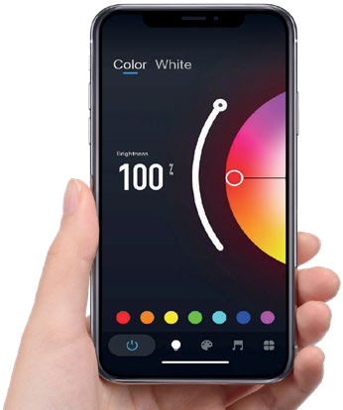

[Dealer Name]
[Your tagline, e.g. Lighting Design and Installation]
[000.000.0000] | [yourwebsite.com]
[City, State] | [License #]
Choose your light
Five tape types, from simple white to full color
Single Color White
Tunable White (CCT)
RGB Color
RGB+W
RGB+CCT
One fixed white. Simple, clean, and efficient for task and accent light.
Adjust from warm to cool white on the same strip to suit the task or time of day.
Millions of colors for accents, parties, holidays, and game day.
Full color plus a dedicated white LED for quality everyday light.
Full color and tunable white in one strip. The most versatile choice.
Seamless, dot-free options: Lighting Leaf PhosCore™ tape produces one continuous line of light with no visible dots, even reflected in glossy counters, tile, and floors.
Set the mood with color temperature
Warmer ← → Cooler
2700K
3000K
3500K
4000K
5000K
Cozy & relaxing
Bedrooms, living rooms
Warm & inviting
Kitchens, dining
Balanced
Baths, laundry, halls
Bright & crisp
Garages, workspaces
Daylight
Task and display
Features, functions, and benefits
Feature | What it does | What it means for you
Slim, flexible strip | Fits under cabinets, in coves, on steps, and in tight spaces | Light exactly where you need it, with the fixture out of sight
Seamless, dot-free glow | Blends LEDs into one continuous line of light | Clean reflections on glossy counters, tile, and floors
90+ CRI color accuracy | Shows colors much the way daylight does | Finishes, food, and skin tones look natural
Dimmable and tunable | Adjusts brightness and warm-to-cool white | One room, many moods: work, relax, entertain
Indirect, reflected light | Softens glare and harsh shadows | Easier on the eyes, and rooms feel larger
Smart control | App, voice, wall remotes, scenes, and schedules | Convenience from anywhere; never come home to a dark house
Energy-efficient LED | Low wattage and long service life | Lower energy use and less upkeep
Control it your way
Why a professional install?
Tap or speak: dim, brighten, and change color by app or smart assistant
Stylish, removable in-wall remotes for everyday use
Scenes for cooking, movie night, and entertaining
Schedules and timers: wake to a gentle glow, come home to a lit house
Power supplies sized to each run for reliable performance
Correct wire gauge for even brightness from end to end
Clean, concealed wiring and finished channel details
Local support from the pro who designed your lighting
YOUR PROJECT
Ask us for a live demo in your own space.
Name
Phone
Address
Email
Rooms
Target date
LED tape lighting by LIGHTING LEAF
[Dealer Name] | [000.000.0000] | [yourwebsite.com]

Slide 3






Make this sheet yours
Dealer setup guide. About 5 minutes in PowerPoint. This page is hidden and will not print.
1
Add your logo
Right-click the YOUR LOGO box, choose Change Picture, then From a File. Your logo drops in at the same size and position. A PNG with a transparent background works best.
2
Add your info
Click each [bracket] field and type over it: dealer name, tagline, phone, website, city, and license number. The footer has a second set of fields. Delete the brackets.
3
Set your brand color
Design tab > Variants > Colors > Customize Colors. Set Accent 1 to your main brand color and Accent 2 to your secondary color, then Save. Every accent on the sheet updates at once.
4
Match your fonts (optional)
Design tab > Variants > Fonts > Customize Fonts. Set Heading and Body to your brand fonts. The sheet uses Arial by default so it opens the same on any computer.
5
Save and print
File > Export > PDF for email and your website. To print, print slides 1 and 2 (front and back) and choose Fit to Page. Save your finished copy as your own master so you only do this once.
Co-brand rules
Your brand leads. Your logo, color, and contact info go at the top and in the footer.
Keep the "LED tape lighting by Lighting Leaf" credit in the footer.
Keep the PhosCore™ name and product descriptions as shown.
Keep product descriptions as written. Check with Lighting Leaf before changing product claims.
You may swap the room photos for your own installed job photos.
Arizona contractors: include your ROC license number where required.
Need help or want us to set it up for you?
Send your logo, brand colors, and contact info to Lighting Leaf dealer support:
sales@lightingleaf.com | 602.625.8608
LED tape lighting by LIGHTING LEAF
lightingleaf.com

